Slide 1
Adaptor
Lecture 19

Slide 2
Intent
Adapter is a structural design pattern that allows objects with incompatible interfaces to collaborate.

Slide 3
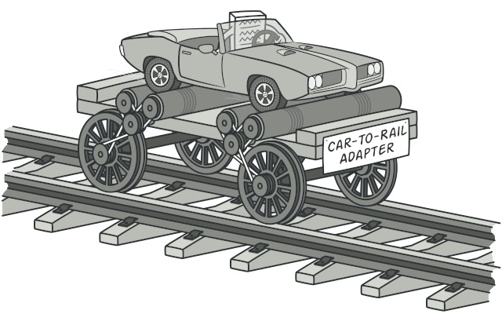

Slide 4
Problem
Imagine that you’re creating a stock market monitoring app. The app downloads the stock data from multiple sources in XML format and then displays nice-looking charts and diagrams for the user.
At some point, you decide to improve the app by integrating a smart 3rd-party analytics library. But there’s a catch: the analytics library only works with data in JSON format.

Slide 5
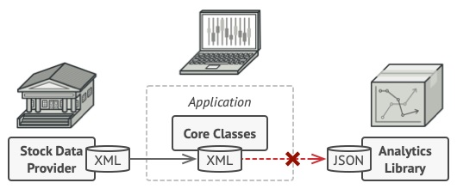

Slide 6
Problem
You could change the library to work with XML.
However, this might break some existing code that relies on the library.
And worse, you might not have access to the library’s source code in the first place, making this approach impossible.

Slide 7
Solution
You can create an adapter. This is a special object that converts the interface of one object so that another object can understand it.

Slide 8
Solution
Adapters can not only convert data into various formats but can also help objects with different interfaces collaborate. Here’s how it works:
The adapter gets an interface, compatible with one of the existing objects.
Using this interface, the existing object can safely call the adapter’s methods.
Upon receiving a call, the adapter passes the request to the second object, but in a format and order that the second object expects.

Slide 9
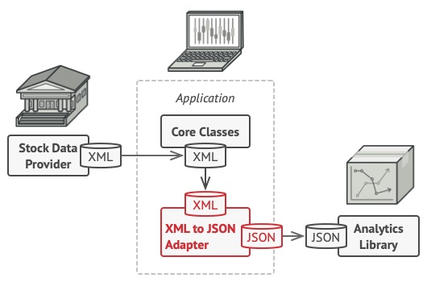

Slide 10
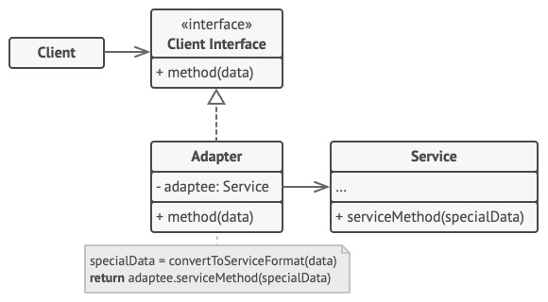

Slide 11
Structure
The Client is a class that contains the existing business logic of the program.
The Client Interface describes a protocol that other classes must follow to be able to collaborate with the client code.
The Service is some useful class (usually 3rd-party or legacy). The client can’t use this class directly because it has an incompatible interface.

Slide 12
Explanation
The Adapter is a class that’s able to work with both the client and the service: it implements the client interface, while wrapping the service object. The adapter receives calls from the client via the adapter interface and translates them into calls to the wrapped service object in a format it can understand.

Slide 13
Explanation
The client code doesn’t get coupled to the concrete adapter class as long as it works with the adapter via the client interface. Thanks to this, you can introduce new types of adapters into the program without breaking the existing client code. This can be useful when the interface of the service class gets changed or replaced: you can just create a new adapter class without changing the client code.

Slide 14
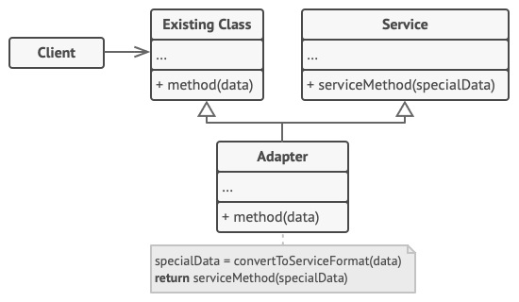

Slide 15
Example
This example of the Adapter pattern is based on the classic conflict between square pegs and round holes.
The Adapter pretends to be a round peg, with a radius equal to a half of the square’s diameter (in other words, the radius of the smallest circle that can accommodate the square peg).

Slide 16


Slide 17
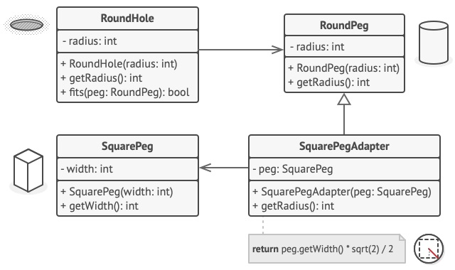

Slide 18
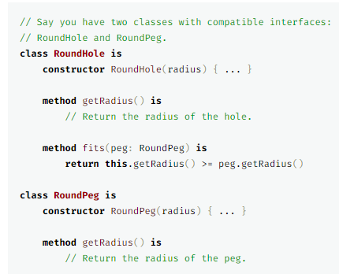

Slide 19
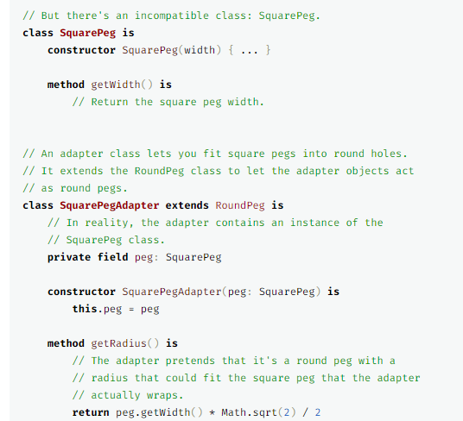

Slide 20
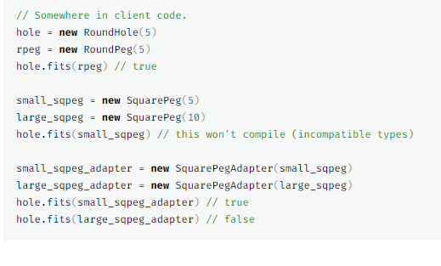

Slide 21
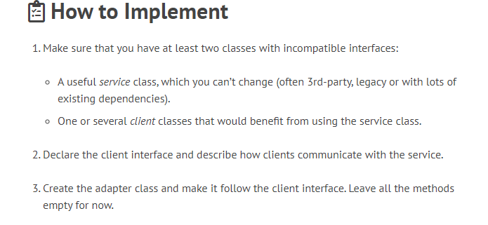

Slide 22
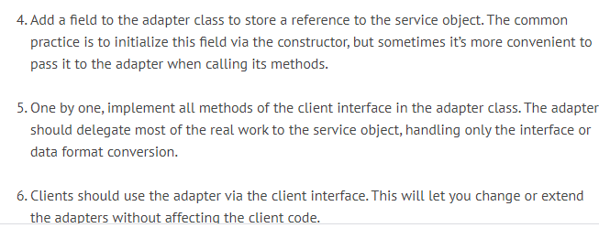

Slide 23
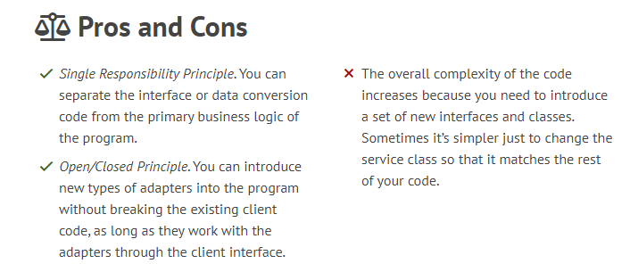

Slide 24
Reference
https://refactoring.guru/design-patterns/adapter

